Slide 1
Income Tax

Slide 2

“In this world nothing can be said to be certain, except death and taxes.” Benjamin Franklin
Tax is a mandatory liability for every citizen of the country. There are two types of tax in India
i.e. Direct and Indirect (Direct taxes are levied on taxpayers income and profits; indirect taxes are charged on goods and services)
Taxation in India is rooted from the ancient period. Present Indian tax system is based on this ancient tax system which was based on the theory of maximum social welfare.

Slide 3
Brief History of Income Tax in India
In India, this tax was introduced for the first time in 1860, by Sir James Wilson in order to meet the losses sustained by the Government on account of the Military Mutiny of 1857.
In 1918, a new income tax was passed and again it was replaced by another new act which was passed in 1922. This Act remained in force up to the assessment year 1961-62 with numerous amendments.
In consultation with the Ministry of Law finally the Income Tax Act, 1961 was passed. The Income Tax Act 1961 has been brought into force with 1 April 1962.
Since 1962 several amendments of far-reaching nature have been made in the Income Tax Act by the Union Budget every year.

Slide 4










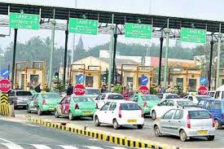


Paying tax almost everywhere!!!

Slide 5

Why should I pay tax?
I have to pay for my food, for my house, for my travel, for my medical treatment, for owning a vehicle not only cost of vehicle but also vehicle tax and what not.
Even on many roads, one has to pay toll tax! They also say that if we compare with countries like USA and UK, the people get social security as also medical facilities virtually without any cost. But India does not offer such facilities.

Slide 6
What Government Do from our TAX?
The Government provide Health care through Government hospitals (usually they offer service without any cost), Education (In Municipal and Government schools the fee is negligible).
Of course the major expenditure of Government has to be incurred on National Defense, Infrastructure Developments etc.
Taxes are used by the government for carrying out various welfare schemes including employment programs.
There are Lakhs of employees in various departments and the administrative cost has to be borne by the Government.

Slide 7
What Government Do from our TAX?
On judicial system: the Salaries, perks of Judges, Magistrates and judicial staff has also to be paid by the Government.
PM Kisan yojana: subsidy / pay-in to farmers.
The Government also provides cooking gas at concessional rate or gives subsidy.
Government also provide support to MSMEs and small business in terms of subsidies.
Thus on considering these various duties of the Government, we need to appreciate that we must pay tax as per law. We have to act like a responsible citizen.

Slide 8
Direct Taxes Personal Taxation

Slide 9
Financial Year (FY 24-25) Assessment Year (AY 25-26)

Slide 10
Heads of Income
Section 14 of the IT Act, 1961, specifies 5 heads of income
Income from Salary
Income from House Property
Income from Profits and Gains from Business or Profession
Income from Capital Gains
Income from Other Sources

Slide 11
Heads of Income - Income from Salary
Income from Salary (Section 15 to 17)
Section 15 describes the taxability of income from Salary (between employee & employer)
Section 16 explains about deductions available under salaries
Section 17 explains the components of the Salary like Monetary compensation, Perquisites, etc.

Slide 12
Heads of Income - Income from Salary
Income from Salary (Section 15 to 17)
Section 15 describes the taxability of income from Salary (between employee & employer)
(a) any salary due from an employer or a former employer to an assesse in the previous year, whether paid or not;
(b) any salary paid or allowed to him in the previous year by or on behalf of an employer or a former employer though not due or before it became due to him;
(c) any arrears of salary paid or allowed to him in the previous year by or on behalf of an employer or a former employer, If not charged to income-tax for any earlier previous year.
Explanation.—For the removal of doubts, it is hereby declared that where any salary paid in advance is included in the total income of any person for any previous year it shall not be included again in the total income of the person when the salary becomes due.

Slide 13
Heads of Income - Income from Salary
Deductions & Exemptions
Deduction from salary in income tax refers to the amount subtracted from an individual’s gross salary to arrive at the taxable income. An exemption refers to the deduction allowed by the law to reduce the amount of income that would otherwise be taxed.
Deductions reduce your taxable income, while exemptions (under section 10) exclude certain types of income from taxation altogether.
Tax deductions are specific expenses or investments that reduce an individual’s taxable income, thus lowering the amount of income tax they are required to pay. The government allows these deductions to encourage individuals to save and invest, purchase insurance policies, and contribute to specific funds and schemes.

Slide 14
Heads of Income - Income from Salary
List of Exemptions
Exemption of Agriculture Income
Exemption on the Income of a HUF (interest are taxable)
Exemption on House Rent Allowance (HRA)
Exemption on allowances (Dearness Allowance, Leave Travel Allowance (LTA) or Leave Travel Concession (LTC), Mobile Reimbursement, Books and Periodicals, Food Coupons, Relocation Allowance, Children Education Allowances, Children's Hostel Allowances, Leave Encashment, Helper, etc)
Notes:
https://www.policybazaar.com/income-tax/section-10/

Slide 15
Heads of Income - Income from Salary
List of Exemptions
Exemption on House Rent Allowance (HRA)
If rent is actually being paid, the individual can get an exemption as per the House Rent Allowance and that will be the least of the following:
Actual House Rent Allowance received
Actual Rent paid minus 10% of basic salary
40% of basic salary (50% in case of Mumbai, Chennai, Kolkata, Delhi)
Components of Salary
Basic
HRA
Allowances, etc
Notes:
https://www.policybazaar.com/income-tax/section-10/

Slide 16

Section 10(13A): House Rent Allowance(HRA)
BASIC | 30,000 | PF | 2,000
HRA | 13,000 | Professional Tax | 200
CONVEYANCE | 2,000
SPECIAL ALLOWANCE | 3,000
MEDICAL ALLOWANCE | 1,250
LTA | 5,000
Total Earnings | 54,250
Basic Salary (no commission & DA) | 30,000*12 =3,60,000/-
10% of Basic Salary | 3,60,000*10% =36,000/-
Rent Paid per month | 10,000/-
Particulars | Calculation | Amount(INR)
a)Actual HRA Received | 13,000*12 | 1,56,000/-
b) 50% of Basic Salary (Mumbai region) | 3,60,000*50% | 1,80,000 /-
c)Rent paid (-)10% of basic salary | (10,000*12)-36,000/- | 84,000/-

Slide 17
Heads of Income - Income from Salary
List of Deductions
Standard deduction (Old Regime - Rs 50,000 & New Regime - Rs 75,000)
Income Tax Deduction under Section 80C upto Rs. 1.5 Lakhs (includes Life insurance, Public Provident Fund, Employee Provident Fund, Equity Linked Savings Scheme, Tuition fees, Home loan repayment (Principal amount), National Savings Certificate, National Pension Schemes, Sukanya Samriddhi Yojana, Tax saving bank deposits and post office deposits, Post Office Senior Citizens Savings Scheme)

Slide 18
Heads of Income - Income from Salary
List of Deductions
Subsections of Section 80C
Section 80CCC - Tax deduction to investments made in annuity plans of life insurance companies.
Section 80CCD - Tax deduction for investments made in government-based pension schemes such as the National Pension Scheme.
Section 80CCF - Tax deduction for investments made in long-term government infrastructure bonds.
Section 80CCG - Tax deduction for the investments made in equity savings schemes approved by the government.

Slide 19
Heads of Income - Income from Salary
List of Deductions
Section 80CCD is further divided into Section 80CCD(1) and Section 80CCD(2)
Under Section 80CCD(1), the allowable tax deduction is 10% of an individual's salary or gross income and 20% of the total gross income for self-employed individuals.
A new amendment is made to this Section introducing Section 80CCD(1B), allowing for a further deduction of up to ₹50,000.
Therefore, the total deduction applicable under Section 80C, Section 80CCD(1) is ₹1,50,000 and an additional deduction of upto ₹50,000 under Section 80CCD(1B).
Under Section 80CCD(2), salaried individuals can additionally claim the amount contributed by the employer to the pension scheme or 10% of their salary.

Slide 20
Heads of Income - Income from Salary
List of Deductions
Section 80D provides a tax deduction for the amount paid as premiums for health insurance plans. It can be for the health insurance plans for self, spouse, children and dependent parents. (The allowable tax deduction is ₹25,000 for self or family and ₹50,000 if you are a senior citizen, ₹50,000 for senior citizen parents)
Section 80DD provides deduction to families of disabled persons for the purpose of caring for a disabled dependent. Deductions under Section-80DD can be claimed by families of disabled dependents and not the dependents themselves. (maximum deduction limit is Rs. 75,000 for medical expenses incurred on a dependent person with a disability. It can go as high as Rs. 1,25,000 for severe disability)

Slide 21
Heads of Income - Income from Salary
List of Deductions
Section 80DDB provides for a deduction to Individuals for medical expenses incurred for the treatment of specified diseases or ailments. Such expense is allowed as a deduction, subject to such conditions, and capped at such amount as specified. (The amount of the deduction depends on two factors - the age of the patient and the actual amount of expenditure. The deduction is up to Rs. 40,000 or the actual amount paid (whichever is less) for patients under 60 years of age and Rs. 1 lakh or the actual amount (whichever is less) for patients above 60 years of age)
List of diseases: Neurological Diseases, Malignant Cancers, Full blown Acquired Immuno Deficiency Syndrome, Chronic Renal Failure, Hematological Disorders.

Slide 22
Heads of Income - Income from Salary
List of Deductions
Section 80E allows you to claim a deduction for the education loan taken from any financial institution or approved charitable institution. There is no maximum limit specified under Section 80E of the Income Tax Act for the deduction on the interest paid on education loans. The deduction is allowed for the actual interest amount paid.
Section 80EE of the Indian Income Tax law allows first-time home buyers to get tax deductions on the interest they need to pay on a Home Loan. You can claim a deduction of up to ₹50,000 per financial year as per this section. You can continue to claim this deduction until you have fully repaid the loan.
Notes:
https://cleartax.in/s/house-property

Slide 23
Heads of Income - Income from Salary
List of Deductions
Section 80EEB of the Income Tax Act allows you to claim tax savings of up to Rs. 1.5 lakh on interest paid on a loan made specifically to purchase an electric car.
The deduction under Section 80EEB is allowed on interest payments in all the subsequent years until the loan is fully paid. The deduction is only applicable for loans sanctioned between January 1, 2019, and March 31, 2023.
Section 80G offers income tax deduction to an assesse, who makes donations to charitable organizations.
Notes:
https://cleartax.in/s/house-property

Slide 24
Heads of Income - Income from Salary
List of Deductions
Section 24 of the Income Tax Act lets homeowners claim a deduction of up to Rs. 2 lakhs on their home loan interest if the owner or his family reside in the house property.
Section 80TTA offers a deduction of up to Rs 10,000 on income earned from savings account interest made in a bank, co-operative society or post office.
Section 80TTB offers a deduction of up to Rs 50,000 on income earned from interest on all kinds of deposits for senior citizens.
Notes:
https://cleartax.in/s/house-property

Slide 25
Heads of Income - Income from Salary
List of Deductions
NO DEDUCTIONS APPLICABLE UNDER NEW TAX REGIME (except standard deduction of Rs 75,000/-)

Slide 26
Heads of Income - Income from Salary
Section 17 of the Act has mentioned the term ‘salary’, which included-
Wages;
Any annuity or pension;
Any gratuity;
Any charges, commissions, perquisites or benefits in lieu of or notwithstanding any compensation or wages;
any advance of salary;
Any payment received by a worker in regard to any time of leave not availed by him;
Notes:
https://blog.ipleaders.in/heads-income/

Slide 27
Heads of Income - Income from Salary
Section 17 of the Act has mentioned the term ‘perquisite’ (something special like a privilege to which a person has a special right because of his social position), which included-
In addition to their salary, the employees are often given some other benefits which may or may not be in cash form. For example, rent-free accommodation or car given by the employer to the employee.
Interest free loans, Movable assets, Educational expenses, Insurance premium paid on behalf of employees
Notes:
https://blog.ipleaders.in/heads-income/

Slide 28
Heads of Income - Income from Salary
Section 17 of the Act has mentioned the term ‘profits in lieu of salary’, which included-
the amount of any compensation due to or received by an assesse from his employer or former employer at or in connection with the termination of his employment or the modification of the terms and conditions relating thereto
Notes:
https://blog.ipleaders.in/heads-income/

Slide 29
SALARY
The amount of tax calculated is directly deducted from your salary before crediting it to your account. This amount deducted by the employer is known as TDS (Tax Deducted at Source).
Gross Salary
It is the total salary before accounting for various deductions. Gross salary can be arrived at by adding the basic salary, HRA, bonus, and allowances.
In-hand or Take-Home Salary
The amount left after all the above adjustments are made is known as the in-hand or take-home salary. It is the salary that employees receive at the end of every month. In other words, it is the amount that is credited into employees’ bank accounts every month.
Here is the formula to calculate in-hand salary –
Net Salary = Basic Salary + Allowances – (Provident fund + Gratuity + TDS + Professional Tax)

Slide 30
TAX SLAB
FINANCIAL YEAR 2024-25 (A.Y. 2025-26)
NEW TAX REGIME
Income Range | Tax Rate
0 - ₹3,00,000 | 0% | NIL
₹3,00,001 - ₹7,00,000 | 5% (tax rebate u/s 87A upto 7 lacs) | 5% on income which exceeds Rs 3,00,000 (Rs 20,000/-) (tax rebate u/s 87A upto 7 lacs)
₹7,00,001 - ₹10,00,000 | 10% | Rs. 20,000 + 10% on income more than Rs 7,00,000 (Rs 50,000/-)
₹10,00,001 - ₹12,00,000 | 15% | Rs. 50,000 + 15% on income more than Rs 10,00,000 (Rs 80,000/-)
₹12,00,001 - ₹15,00,000 | 20% | Rs. 80,000 + 20% on income more than Rs 12,00,000 (Rs 1,40,000/-)
Above ₹15,00,000 | 30% | Rs. 1,40,000 + 30% on income more than Rs 15,00,000
Cess | 4% p.a. of Taxable Income
Notes:
https://economictimes.indiatimes.com/wealth/income-tax-slabs?from=mdr

Slide 31
Example - NEW TAX REGIME
FINANCIAL YEAR 2024-25 (A.Y. 2025-26)
Particulars | Amount (In Rs)
Gross total income | 20,00,000
Standard deduction from salary/pension | (75,000)
Deduction under section 80CCD (2) | (2,00,000)
Net taxable income | 17,25,000
Total income tax liability Rs 2,07,500/-
The final tax payable on gross income of Rs 20 lakh is Rs 2,15,800 (including 4% cess), after claiming deductions of Rs 2.75 lakh.
Notes:
https://economictimes.indiatimes.com/wealth/income-tax-slabs?from=mdr

Slide 32
TAX SLAB
FINANCIAL YEAR 2024-25 (A.Y. 2025-26)
OLD TAX REGIME*
Income Range | Tax Rate
0 - ₹2,50,000 | 0%
₹2,50,001 - ₹5,00,000 | 5%
₹5,00,001 - ₹10,00,000 | 20%
Above ₹10,00,001 | 30%
Cess | 4% p.a. of Taxable Income
*APPLICABLE TO NON-SENIOR CITIZEN
Notes:
https://economictimes.indiatimes.com/wealth/income-tax-slabs?from=mdr

Slide 33
Example - OLD TAX REGIME
FINANCIAL YEAR 2024-25 (A.Y. 2025-26)
Particulars | Amount (in Rs)
Gross total income | 17,00,000
Section 80C | (1,50,000)
Section 80 CCD(1b) NPS investment | (50,000)
Section 80D – medical insurance premium | (25,000)
Section 80TTA | (10,000)
Net taxable income | 14,65,000
Total income tax liability Rs 2,52,000/-
The final tax payable on gross income of Rs 17 lakh is Rs 2,62,080 (including 4% cess), after claiming deductions of Rs 2.75 lakh.
Notes:
https://economictimes.indiatimes.com/wealth/income-tax-slabs?from=mdr

Slide 34
SURCHARGE
If an individual's net taxable income exceeds a specified level, then a surcharge is levied.
The surcharge is levied on the income tax payable amount before the levy of cess.
According to income tax laws, a surcharge is applicable if an individual's taxable income exceeds Rs 50 lakh.

Slide 35
SURCHARGE
Surcharge rate from April 1, 2023 under NEW TAX REGIME
Income range | Surcharge rate
Up to Rs 50 lakh | Nil
More than Rs 50 lakh but up to Rs 1 crore | 10%
More than Rs 1 crore but up to Rs 2 crore | 15%
More than Rs 2 crore | 25%
Surcharge rate under OLD TAX REGIME
Income range | Surcharge rate
Upto Rs 50 lakh | Nil
More than Rs 50 lakh but up to Rs 1 crore | 10%
More than Rs 1 crore but up to Rs 2 crore | 15%
More than Rs 2 crore but up to Rs 5 crore | 25%
More than Rs 5 crore | 37%
Notes:
https://economictimes.indiatimes.com/wealth/income-tax-slabs?from=mdr

Slide 36
SURCHARGE
There are certain exceptions to the surcharge rates mentioned above. If an individual has earned income from capital gains (short term or long term) through the sale of equity shares and equity mutual funds or dividend income, the surcharge will not exceed 15%, irrespective of the income range.
While understanding the concept of surcharge, one must also know the term marginal relief. The concept of marginal relief kicks in when the amount of surcharge on income tax payable exceeds the increase in income over the specified limit.
Notes:
https://economictimes.indiatimes.com/wealth/income-tax-slabs?from=mdr

Slide 37
SURCHARGE
Suppose an individual has a net taxable income of Rs 51 lakh. As the income exceeds Rs 50 lakh, the surcharge will be applicable at the rate of 10%.
The tax payable on Rs 51 lakh (without surcharge) is Rs 13,42,500. The surcharge amount will be Rs 1,34,250 (at 10% of tax payable).
Here the surcharge amount Rs 1,34,250 is higher than the additional income above Rs 50 lakh (Rs 1,00,000). This is where the concept of marginal relief kicks in.
Notes:
https://economictimes.indiatimes.com/wealth/income-tax-slabs?from=mdr

Slide 38
SURCHARGE
To know the amount of marginal relief that is applicable, one needs to calculate income tax payable on Rs 50 lakh. This is because no surcharge will be applicable till the income exceeds Rs 50 lakh. The income tax payable will be Rs 13,12,500.
Now add income above Rs 50 lakh (Rs 1 lakh) to the income tax payable amount. The tax payable amount under marginal relief will be Rs 14,12,500.
Notes:
https://economictimes.indiatimes.com/wealth/income-tax-slabs?from=mdr

Slide 39
SURCHARGE
To ascertain the actual income tax payable with surcharge, compare the normal tax liability (before surcharge and cess) and tax liability after marginal tax relief (without cess).
Normal tax liability is Rs 13,42,500 and tax liability after marginal tax relief is Rs 14,12,500. The surcharge that will be applicable is Rs 70,000 (Rs 14,12,500 - Rs 13,42,500).
The final tax payable amount will be Rs 13,42,500 (Tax payable amount) + Rs 70,000 (Surcharge) + Rs 56,500 (Cess at 4% on Rs 14,12,500) = Rs 14,69,000.
Notes:
https://economictimes.indiatimes.com/wealth/income-tax-slabs?from=mdr

Slide 40
Surcharge without Marginal Relief |  |  |  | Surcharge with Marginal Relief
Tax | Taxable Income | ₹ 51,00,000.00 |  | Tax | Taxable Income | ₹ 50,00,000.00
0% | 0 to 250000 | ₹ - |  | 0% | 0 to 250000 | ₹ -
5% | 250000 to 500000 | ₹ 12,500.00 |  | 5% | 250000 to 500000 | ₹ 12,500.00
20% | 500000 to 1000000 | ₹ 1,00,000.00 |  | 20% | 500000 to 1000000 | ₹ 1,00,000.00
30% | above 1000000 | ₹ 12,30,000.00 |  | 30% | above 1000000 | ₹ 12,00,000.00
 | Total tax | ₹ 13,42,500.00 |  |  | Total tax | ₹ 13,12,500.00
 | Surcharge @10% | ₹ 1,34,250.00 |  |  | add tax | ₹ 1,00,000.00
 | Total Tax | ₹ 14,76,750.00 |  |  | Total tax | ₹ 14,12,500.00
 | CESS @4% | ₹ 59,070.00 |  |  | CESS @4% | ₹ 56,500.00
 | Tax Payable | ₹ 15,35,820.00 |  |  | Tax Payable | ₹ 14,69,000.00
 |  |  |  |  | Benefit | ₹ -66,820.00
 | Tax Liability after MR | ₹ 14,12,500.00
 | Normal Tax Liability | ₹ 13,42,500.00
 | Surcharge Applicable | ₹ 70,000.00
 | Total Tax | ₹ 14,12,500.00
 | CESS @4% | ₹ 56,500.00
 | Tax payable | ₹ 14,69,000.00

Slide 41
Rules that Govern NRI Status
Under the legislation in India, there exist two primary laws that establish and outline the regulations pertaining to Non-Resident Indians (NRIs) as follows:
Income Tax Act: This law governs the obligations related to taxation for NRIs.
Foreign Exchange and Management Act (FEMA): This law regulates various aspects such as transactions, investments, the establishment of bank accounts, and more, concerning NRIs.

Slide 42
Important Terminologies
Residential Status
Resident – World income is taxable in India
Non Resident Indian (NRI) – Only income arising or accruing in India is taxable in India
The Reserve Bank of India (RBI) and the Income Tax Act have distinct definitions of an NRI. The definition of NRI as per RBI focuses on the intention of stay, whereas NRI status as per income tax is determined by the actual duration of stay in India.

Slide 43
Important Terminologies
RBI's NRI Definition: An individual is an NRI if they've not resided in India for more than 182 days during the relevant financial year.
Income Tax Act's NRI Definition: An individual is an NRI if they've been in India for less than 182 days in the relevant financial year or if they've been in India for less than 60 days during the year and 365 days or less during the past four years.

Slide 44
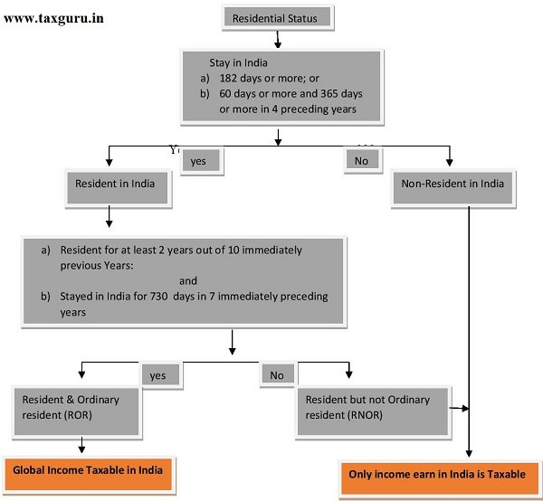

Slide 45
New Rules to Determine NRI Status
An Indian citizen is considered a resident for a financial year if he/she fulfills any of the basic conditions mentioned below:
You should be physically present in India for 182 days or more during the relevant financial year. Or
Your physical presence in India during the applicable financial year is 60 days or more and 365 days or more in the preceding four financial years.
An Indian citizen having total income, excluding income from foreign sources, exceeding Rs. 15 lakh during the relevant financial year. He should not be liable to pay tax in any other country or territory by reason of his domicile or any other criteria of similar nature.

Slide 46
The condition of 60 days is extended to 182 days if the individual leaves India for employment abroad.
For an Indian citizen or a person of Indian Origin (PIO) who resides outside India and visits India, the condition of 60 days is extended to 120 days, if the total income of such a person in India is more than Rs. 15 lakh.
However, if the total income (excluding the income from foreign sources) is equal to or less than Rs. 15 lakh, the condition of 60 days is extended to 182 days.

Slide 47
HEADS OF INCOME
Income From Salary
Meaning of Salary:
Wages
Pension
Annuity
Gratuity
Advance Salary paid
Fees, Commission, Perquisites, Profits in lieu of or in addition to Salary or Wages
Annual accretion to the balance of Recognized Provident Fund
Leave Encashment
Transferred balance in Recognized Provident Fund
Contribution by Central Govt. or any other employer to Employees Pension A/c as referred in Sec. 80CCD.

Slide 48
What is CTC?
CTC stands for “Cost to Company”. It is a commonly used term in employment and jobs. CTC is defined as the total amount of money that the company is going to spend on an employee. It will include salary, bonuses, incentives, provident fund. It is the total amount that an employee can expect from the company in the form of different direct and indirect benefits. While salary is the most basic form of compensation that an employee receives from the company, CTC is made by adding up salary and other components.
CTC (Cost to Company) = Gross Salary + Benefits

Slide 49
1. Basic Salary: It is a fixed amount of money on an employment contract that is mutually determined and provided monthly to an employee for their financial needs.
2. House Rent Allowance: Employee is eligible for this if they are living on rent. It is some part of the complete rent of the place where the employee lives.
3. Bonuses: Performance-based bonuses are also provided to employees in some companies.
4. Stock Options: Stock options mean employee gets the option to buy the company’s share at a predetermined price in the future.
5. Employee’s Benefits: Benefits paid to employees like health insurance, life insurance, retirement benefits, and any other perks the company offers.
6. Provident Fund (PF) and Gratuity: Employer contributions to the Employee Provident Fund (EPF) and gratuity, which is payable upon an employee’s retirement, are also part of the CTC.

Slide 50
Example of CTC Calculation
Example:
Suppose an employee has a basic salary of ₹40,000 per month, and receives the following allowances and incentives,
Dearness Allowance (DA) amounts to ₹4,000
House Rent Allowance (HRA) is ₹8,000
Conveyance Allowance is ₹1,000
Entertainment Allowance is ₹1,000
Overtime Allowance is ₹1,000
Medical Reimbursements are ₹1,250
Solution:
The employee’s gross salary is calculated as follows:
Gross Salary = Basic Salary + DA + HRA + Conveyance Allowance + Entertainment Allowance + Overtime Allowance + Medical Reimbursements
Gross Salary =
₹40,000 + ₹4,000 +₹8,000 + ₹1,000 + ₹1,000 + ₹1,000 + ₹1,250
Gross Salary = ₹56,250 Per Month.
Gross Salary = ₹6,75,000 Per Year

Slide 51
Now, assuming the employer also provides the following additional benefits to the employee,
Medical Insurance is ₹2,000 per year.
The Provident Fund, which is 12% of the Basic Salary (i.e., 12% of ₹40,000 = ₹4,800 per month).
A Laptop is provided at a one-time expense of ₹50,000.
The gratuity is ₹2,000 per month.
So, the CTC will be the Sum of All Benefits and Salary
Sum of Benefits + Gross Salary Per Year =
₹2,000 + (₹4,800 x 12 months) + ₹50,000 + (₹2,000 x 12 months) + (₹56,250 x 12 months)
Cost to Company (CTC) = ₹8,08,600.

Slide 52
Difference between Cost to Company (CTC) and Salary
Basis | Cost to Company (CTC) | Salary
Definition | It is a total package including both salary and benefits offered by the managing company. | The amount received by the employee as take-home pay.
Components | Includes all monetary and non-monetary components, such as basic salary, allowances, bonuses, benefits, and more. | Typically consists of the basic salary and allowances, which are the taxable components.
Employee’s Perception | Can appear larger, but not all of it is available as take-home pay. | Represents what an employee takes home and can budget with.
Negotiation Tool | Often used as a negotiation tool during job offers and can be higher than the actual salary. | It is for understanding the actual income an employee will receive and managing expenses.
Calculation | Calculated by summing up all the components that make up the total compensation package, often on an annual basis. | It is the actual money provided every month to employees.

Slide 53
Income From Salary
1. CTC
2. Gross Salary
-is employee provident fund (EPF) and gratuity subtracted from the Cost to Company (CTC). To put it in simpler terms, Gross Salary is the amount paid before deduction of taxes or other deductions and is inclusive of bonuses, over-time pay, holiday pay, and other differentials.
For the same example listed above, let’s deduce Mr. A yearly salary by subtracting gratuity and Employee Provident Fund contributions.
Rs. 4,00,000 - Rs. 21,600 - Rs. 18,326 = Rs. 3,60,074

Slide 54
Income From Salary
Particulars | Amount
Basic Salary | —
Add: | —
1. Fees, Commission and Bonus | —
2. Allowances | —
3. Perquisites (Company car, fuel reimbursement etc) | —
4. Retirement Benefits | —
5. Fees, Commission and Bonus | —
Gross Salary | —
Less: Deductions from Salary | —
1. Entertainment Allowance u/s 16 | —
2. Professional Tax u/s 16 | —
Net Salary | —

Slide 55
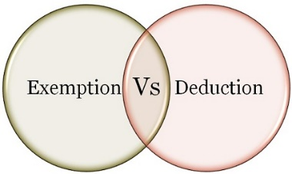
Income From Salary
Deduction/Exemption
What is the difference between Exemption and deduction?
If an income is exempt from tax, then it is not included in the computation of income. However, the deduction is given from income chargeable to tax. Exempt income will never exceed the amount of income. However, the deduct may be less than or equal to or more than the amount of income.
Exemption: Section 10 deals with exemptions
Deduction: Section 80 C to 80 U deals with deduction

Slide 56

Income From Salary
Exemption
Section 10(1) to Section 10(38) Deals with exempt Income
Section 10(5)-Leave Travel Allowance
The bills for your travel against LTA can be claimed for exemption. It is allowed to be claimed twice in a block of four years. The current block is 2018 to 2022.
Exempt from tax in the hands of employee as per following.
If journey by Air –Economy class fare of the national carrier( Air India) by shortest route or the amount spent whichever is less.
If journey by Rail – AC First class fare by shortest route or the amount spent whichever is less
Where places of origin of Journey and destination are connected by rail & journey is performed by any other mode of transport- AC First class fare by shortest route or the amount spent whichever is less.
Where places of origin of Journey and destination are not connected by rail,
a) Recognized public transport exists- First class or deluxe class fare by the shortest route or the amount spent, whichever is less.
b) No recognized public transport exists - AC First class rail fare by Shortest route or the amount spent whichever is less

Slide 57
Income From Salary
Exemption
Section 10(1) to Section 10(38) Deals with exempt Income
Section 10(5)-Leave Travel Allowance Conditions:
LTA should be uniform to all the employees
Employers need to collect and scrutinize the proof of travel (ticket etc.)
Limited to the actual expenses incurred
Any Leave encashed for the purpose of Leave travel or home travel concession is taxable.
Foreign Travel – The exemption is not available in case of Foreign Travel
The Exemption is not available to more than 2 surviving children of an individual born after 1.10.1998. However, this restriction is not there in respect of children born before 1.10.1998.

Slide 58
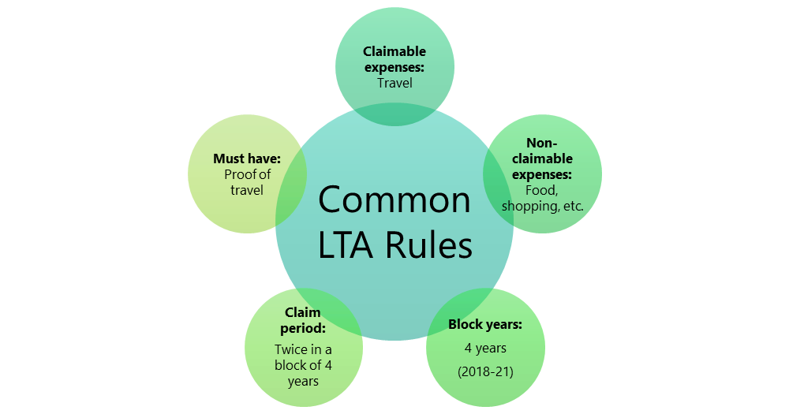
Income From Salary
Exemption
Section 10(5)-Leave Travel Allowance

Slide 59
Income From Salary
Exemption
Section 10(13A): House Rent Allowance(HRA)
This is the famous exemption which is used by many salaried individuals. However, the wrong belief is that whatever the rent they pay is actually exempted from their income. The reality is different. The amount of exemption is least of the following.
a) Actual HRA Received
b) 40% of Salary (50%, if house situated in Metro Region)
c) Rent paid minus 10% of salary
(Salary = Basic + DA (if part of retirement benefit) + Turnover based Commission)

Slide 60
Income From Salary
Exemption
Allowances Exempt under Section 10(14)(I)-No limit
Travelling Allowance
Daily Allowance
Conveyance Allowance:-This is the different allowance than transport allowance. It is the expenditure granted to an employee to meet the expenses on conveyance in performing of his office duties.
Helper Allowance
Academic Allowance:- Allowance granted for encouraging academic, research & training pursuits in educational & research Institutional.
Uniform allowance

Slide 61

Deductions under Chapter VI-A
Section 80C
Maximum Limit- Rs.1,50,000/-
You can save tax on salary income from this section alone
Different Investment in this section includes
Life Insurance premium (Paid by an individual, spouse, and child. In the case of HUF, on the life of any member of HUF).
EPF-Employee contribution can be claimed for deduction.
Public Provident Fund (Paid by an individual, spouse, and child. In the case of HUF, on the life of any member of HUF).
National Savings Certificate (NSC).
Sukanya Samriddhi Account
ELSS or Tax Saving Mutual Funds
Senior Citizen Savings Scheme
5-Years Post Office or Bank Deposits.
Tuition fee of kids.
Principal payment towards home loan.
Stamp duty and registration cost of the house.

Slide 62

Deductions under Chapter VI-A
Section 80CCC
Deduction under Sec.80CCC is available only for individuals. Contribution to an annuity plan of the LIC of India or any other insurer for receiving the pension. Do remember that the amount should be paid or deposited out of income chargeable to tax.
Note:- this is also the part of the combined limit of Rs.1.5 lakh available under Sec.80C Sec.80CCC, and Sec.80CCD(1)

Slide 63
Deductions under Chapter VI-A
NPS Tax Benefit-Section 80CCD1
An individual’s maximum 20% of annual income (Earlier it was 10% but after Budget 2017, it increased to 20%) or an employees (10% of Basic+DA) contribution will be eligible for deduction.
Note:- this is also the part of the combined limit of Rs.1.5 lakh available under Sec.80C Sec.80CCC, and Sec.80CCD(1)
NPS Tax Benefit-Section 80CCD2
There is a misconception among many that there is no upper limit for this section. However, the limit is least of 3 conditions.
1) Amount contributed by an employer,
2) 10% of Basic+DA and
3) Gross Total Income.
This is additional deduction which will not form the part of Sec.80C limit.
The deduction under this section will not be eligible for self-employed.

Slide 64
Deductions under Chapter VI-A
NPS Tax Benefit-Section 80CCD(1B)
This is the additional tax benefit of up to Rs.50,000 eligible for income tax deduction and was introduced in the Budget 2015, One can avail the benefit of this Sect.80CCD (1B) from FY 2015-16.
Both self-employed and employees are eligible for availing this deduction.
This is over and above Sec.80CCD (1).

Slide 65
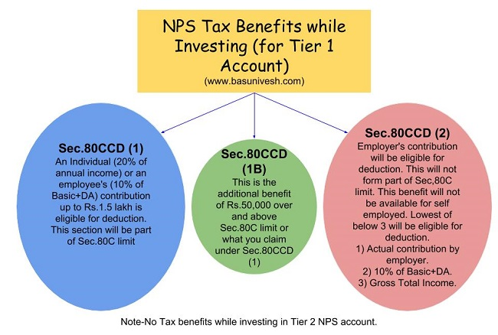
Deductions under Chapter VI-A
NPS Tax Benefit Summary

Slide 66
Deductions under Chapter VI-A
Section 80GG
This section only applies to those who have not availed HRA in their salary or not claiming the deduction on their rent in any of the other sections of income
Conditions:
Applicable to Individual or HUF.
Tax Payer may be either salaried or a self-employed. However, must not be getting HRA.
Tax Payer himself or spouse/Minor Child/HUF of which he is a member should not own any accommodation at a place where he is doing a job or business
If Tax Payer owns a house at a place other than the place noted above, then the concession in respect of self-occupied property is not claimed by him [Under Section 23 (2) (a) or 23 (4) (a)].
Tax Payer has to file a declaration in Form No.10BA regarding the expenditure incurred by him towards the payment of rent.

Slide 67
Deductions under Chapter VI-A
Section 80GG
How much amount of deduction one can avail under Sec. 80GG?
If the all five conditions are satisfied, the amount deductible under Section 80GG is LEAST OF THE FOLLOWING.
Rs.5, 000 per month;
25% of total income of taxpayer for the year; or
Rent Paid less 10% of total income (Rent Paid-10% of Total Income).

Slide 68
Deductions under Chapter VI-A
Section 80GG
Example:
What is total income for the purpose of Sec. 80GG?
We can calculate it as below.
Total Income=Gross Total Income-LTCG-STCG-Income referred under the Sec.115A-Amount deductible under Sec.80C to 80U (except Section 80GG)
Mr. X’s total income (calculated as per above formula) is Rs.4, 00,000. He pays an annual rent of Rs.1, 50,000. Then least of the below will be applicable for deduction under Sec. 80GG.
Rs.60, 000 per year.
Rent Paid-10% of Total Income=Rs.1,50,000-Rs.40,000=Rs.1,10,000’-.
25% of Total Income i.e. Rs.1, 00,000/-.
So least of the above will be Rs.60, 000/-, which one can claim under Section 80GG for that particular FY.

Slide 69

Income Tax E-Filing ( ITR-1)
Total ITRs are – ITR 1 to ITR 7
ITR-1
i. Earlier ITR-1 was applicable for both Residents, Residents Not ordinarily resident (RNOR) and also Non-residents. Now, this form has been made applicable only for resident individuals ii. The condition of the individual having income from salaries, one house property, other income and having total income up to Rs 50 lakhs continues iii. There is a requirement to furnish a break-up of salary. Until now, these details would appear only in Form 16 and the requirement to disclose them in the return had never arisen iv. There is also a requirement to furnish a break up of Income under House Property which was earlier mandatory only for ITR -2 and other forms

Slide 70
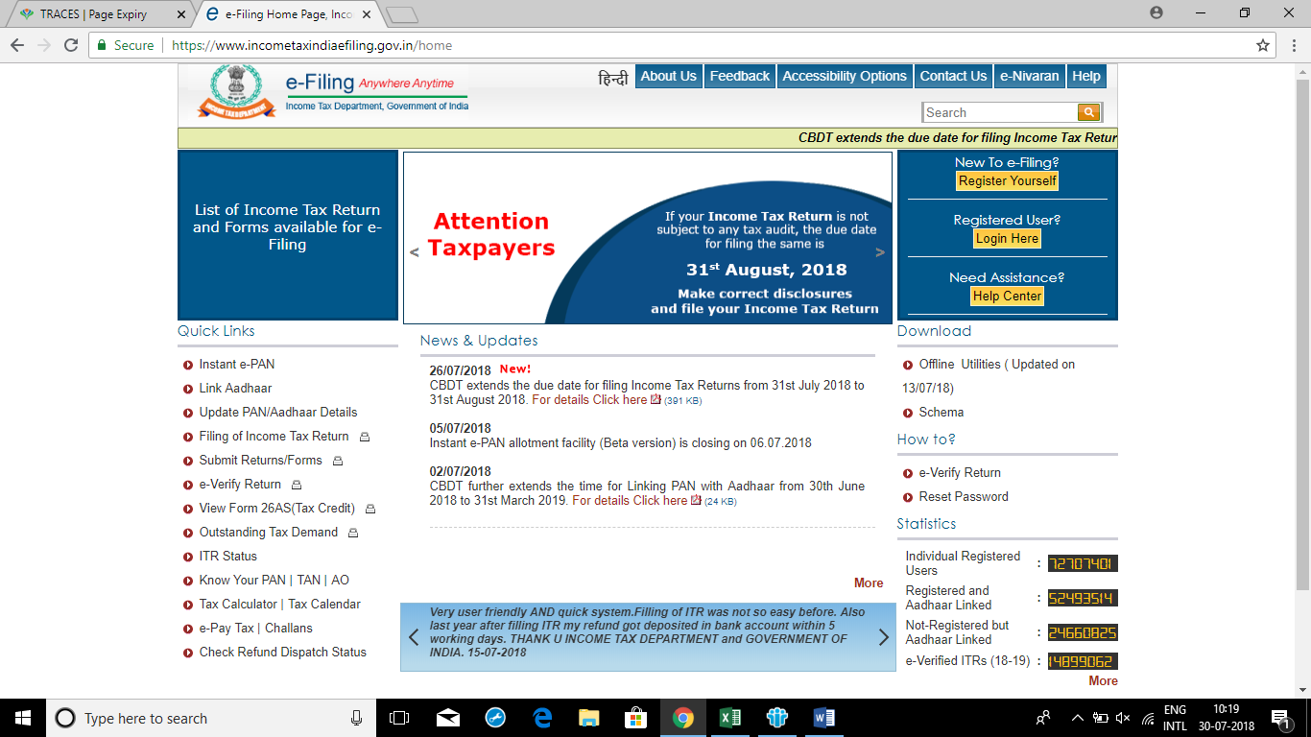
Income Tax E-Filing ( ITR-1)

Slide 71
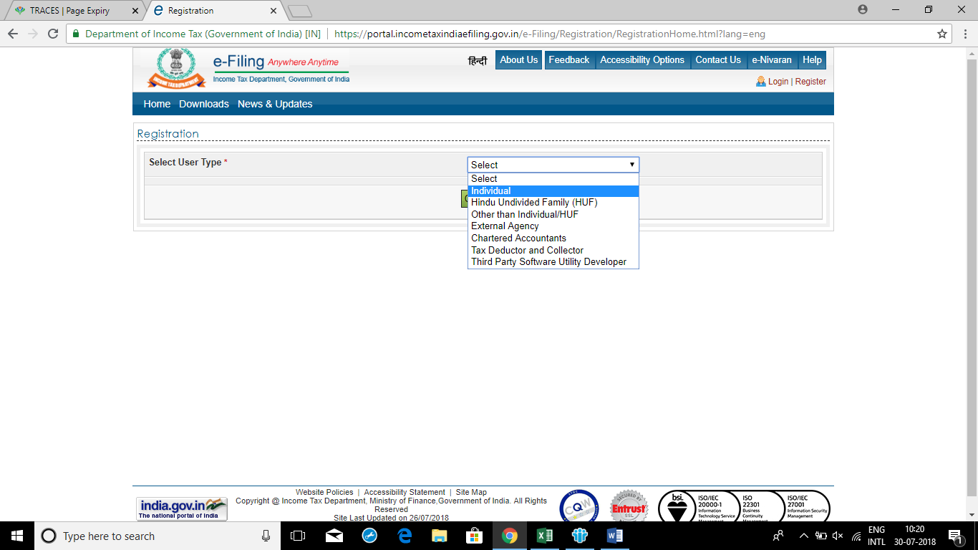
Income Tax E-Filing ( ITR-1)

Slide 72
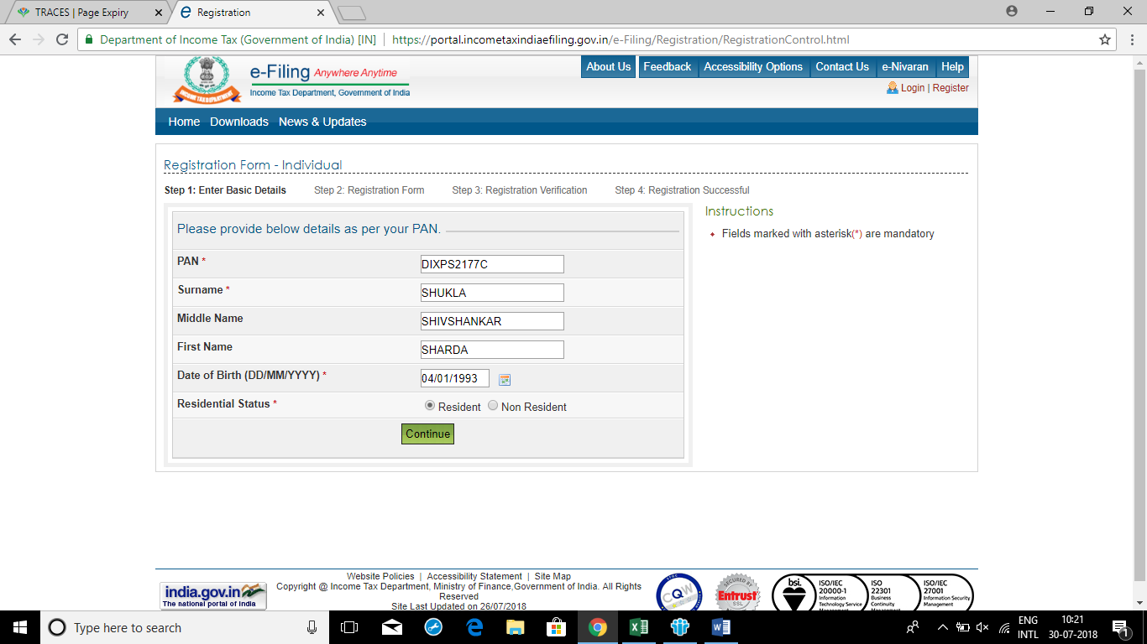
Income Tax E-Filing ( ITR-1)

Slide 73
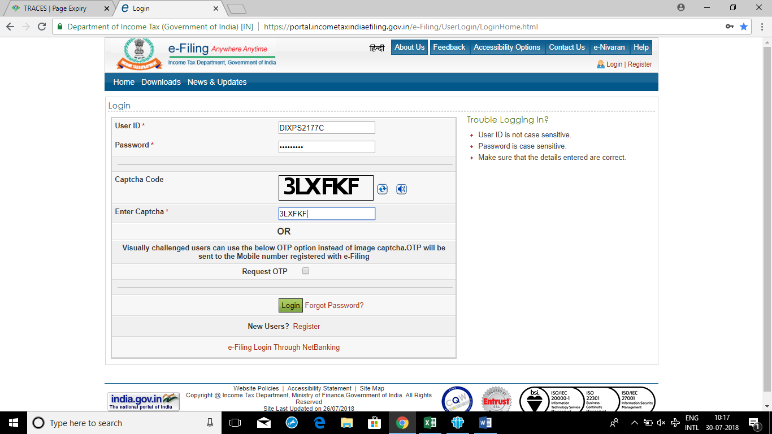
Income Tax E-Filing ( ITR-1)

Slide 74
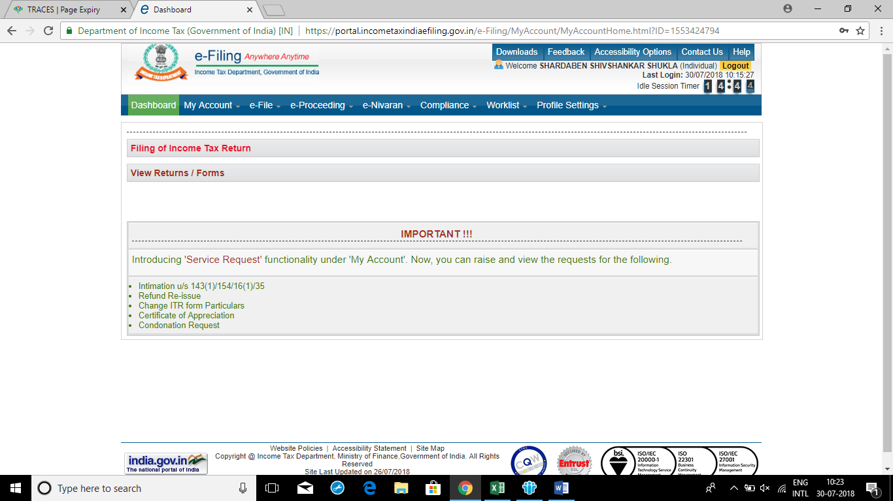
Income Tax E-Filing ( ITR-1)

Slide 75
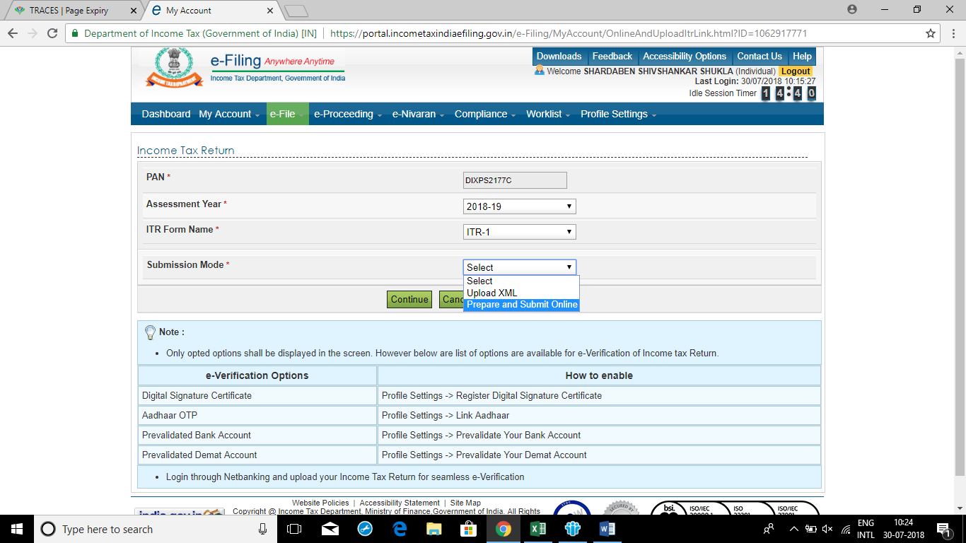
Income Tax E-Filing ( ITR-1)

Slide 76
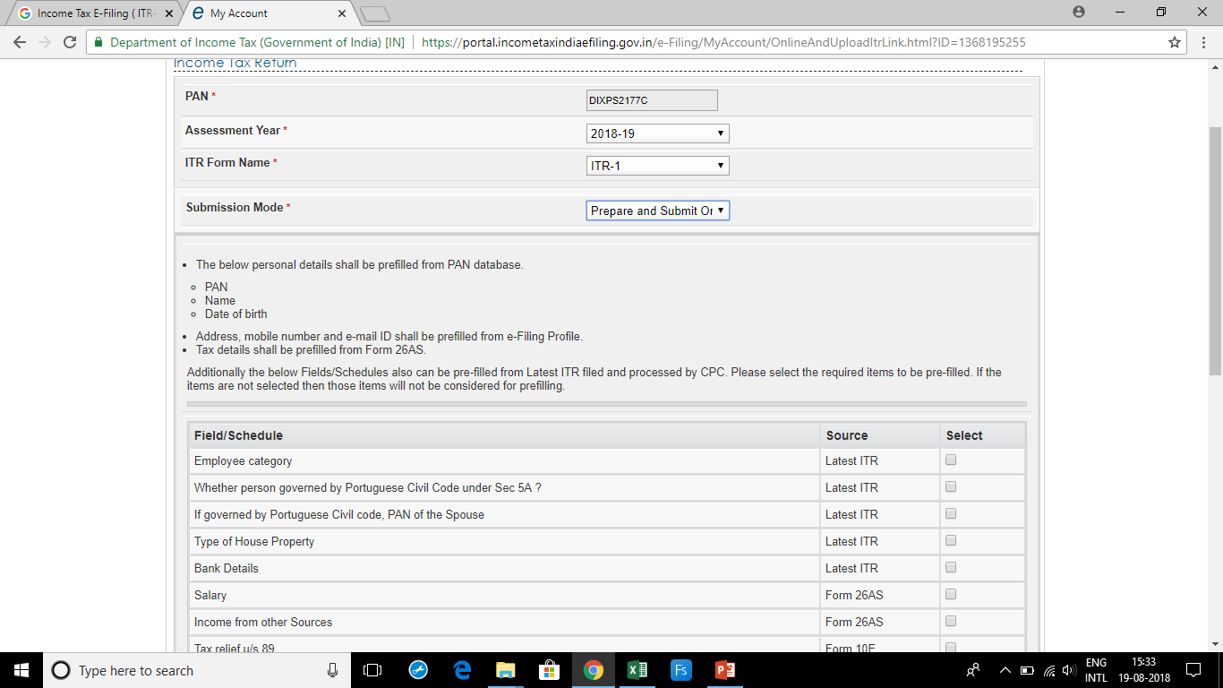
Income Tax E-Filing ( ITR-1)

Slide 77
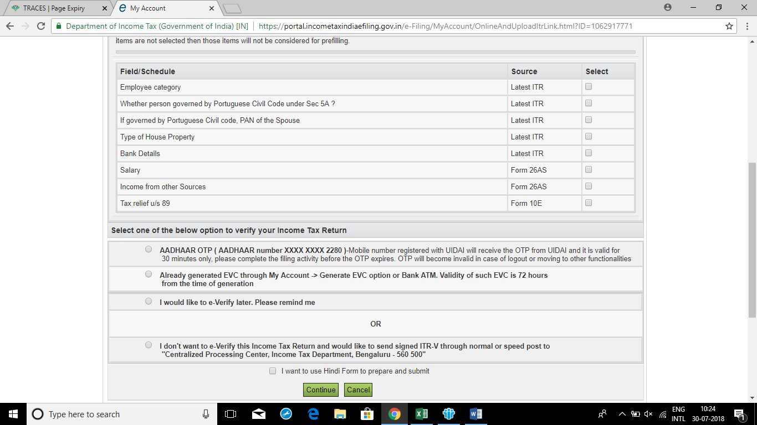
Income Tax E-Filing ( ITR-1)

Slide 78
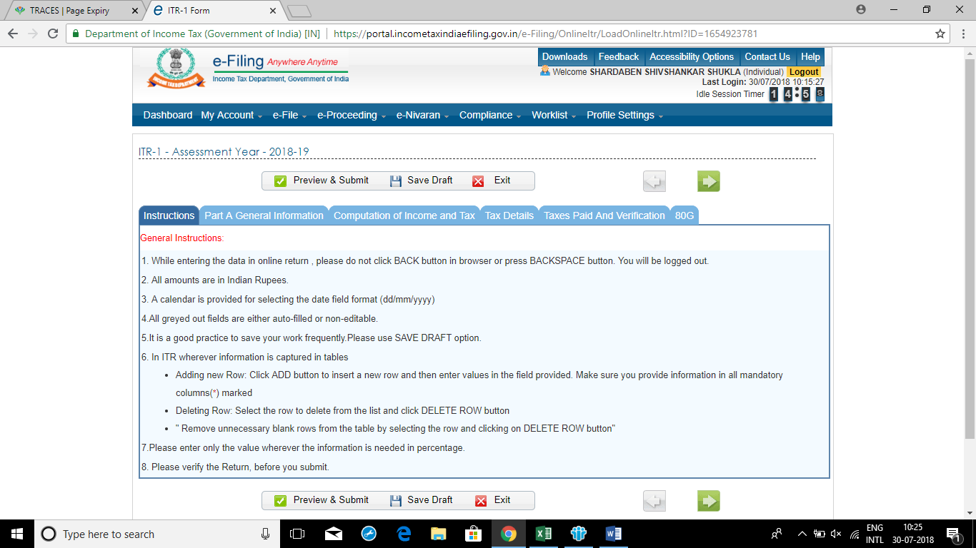
Income Tax E-Filing ( ITR-1)

Slide 79
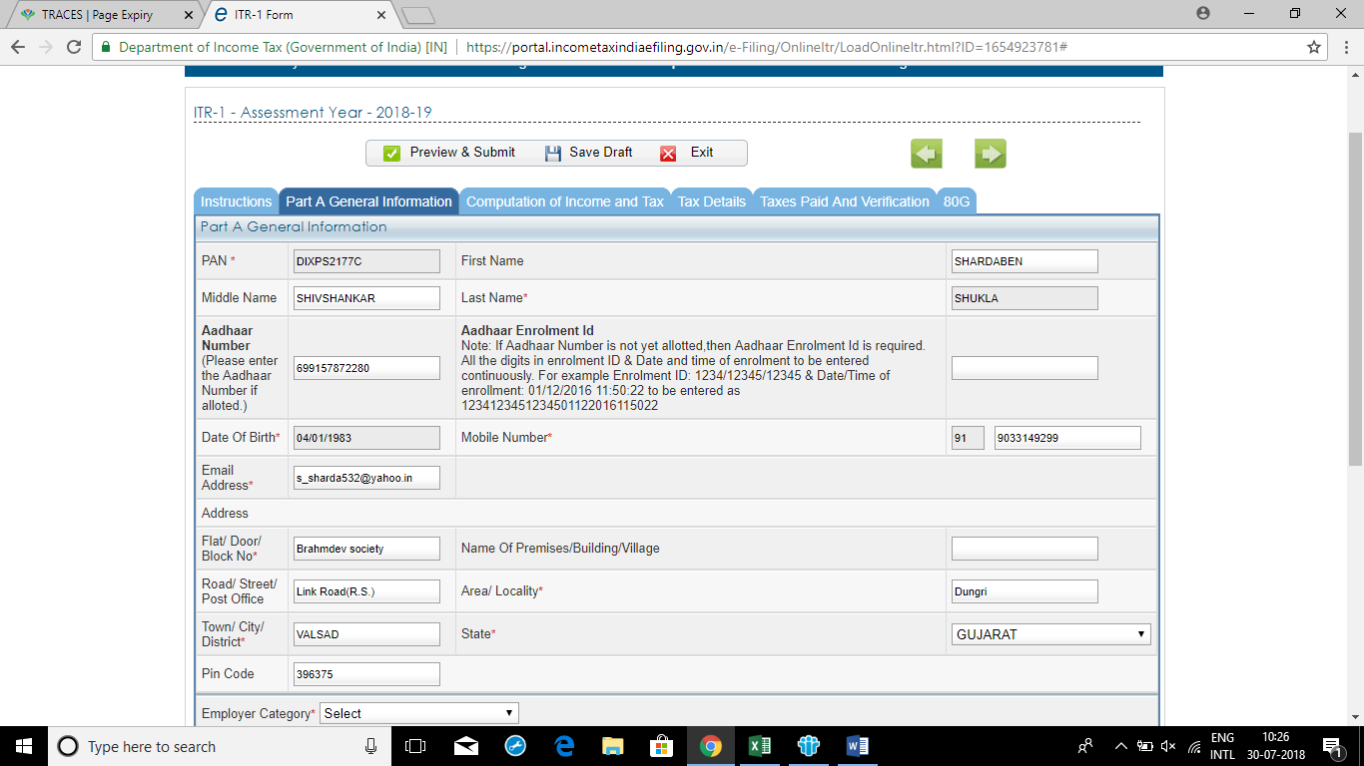
Income Tax E-Filing ( ITR-1)

Slide 80
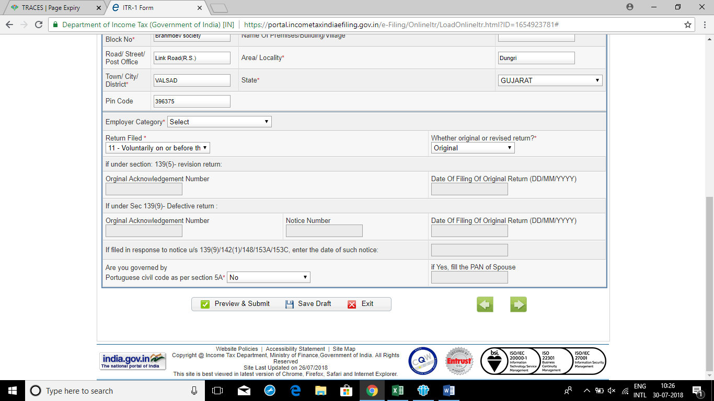
Income Tax E-Filing ( ITR-1)

Slide 81
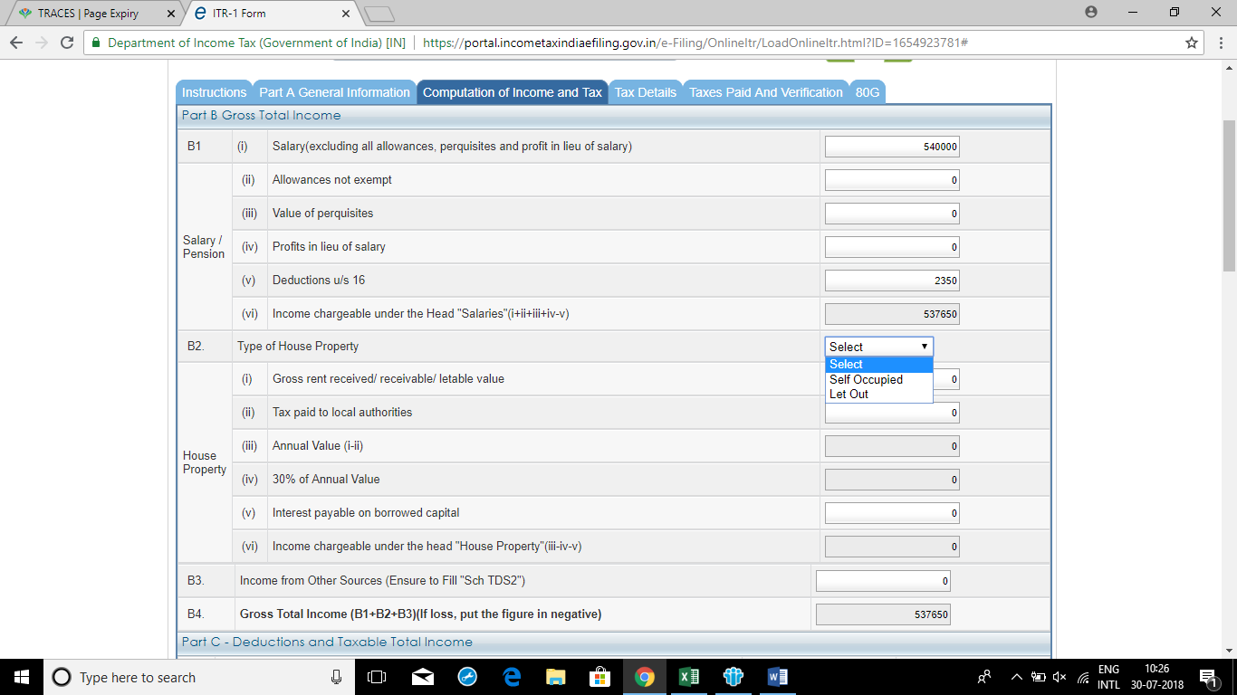
Income Tax E-Filing ( ITR-1)

Slide 82
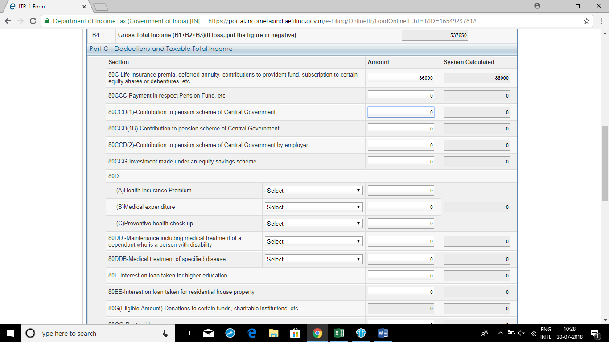
Income Tax E-Filing ( ITR-1)

Slide 83
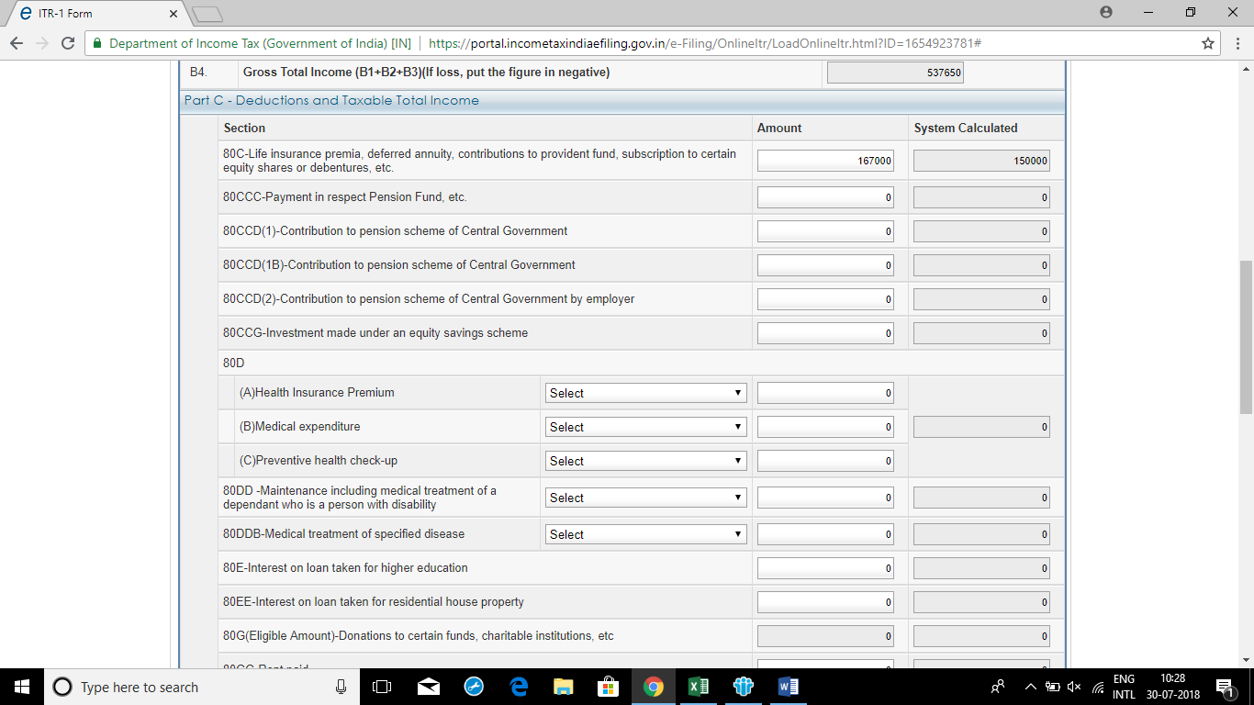
Income Tax E-Filing ( ITR-1)
Limit- Rs. 1,50,000/-

Slide 84
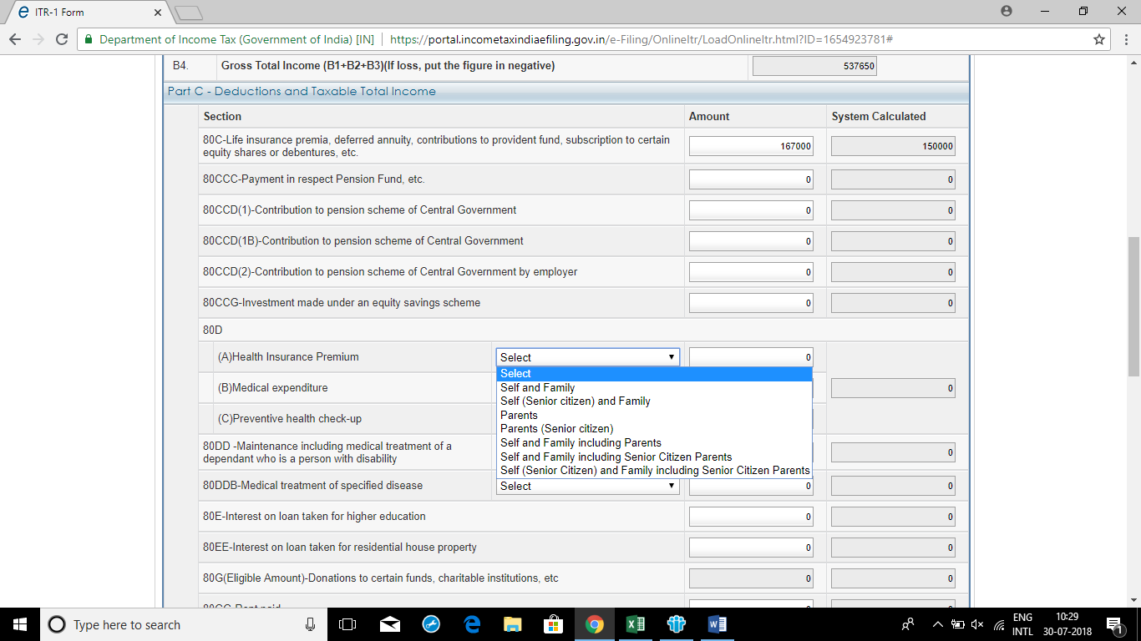
Income Tax E-Filing ( ITR-1)

Slide 85
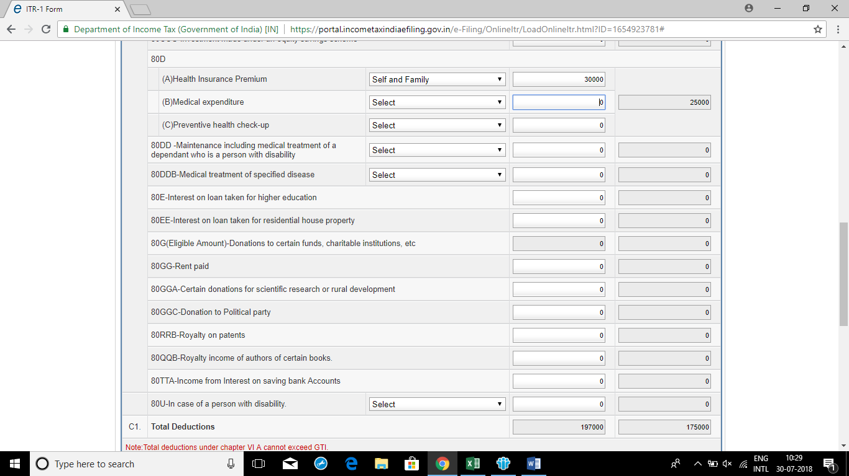
Income Tax E-Filing ( ITR-1)

Slide 86
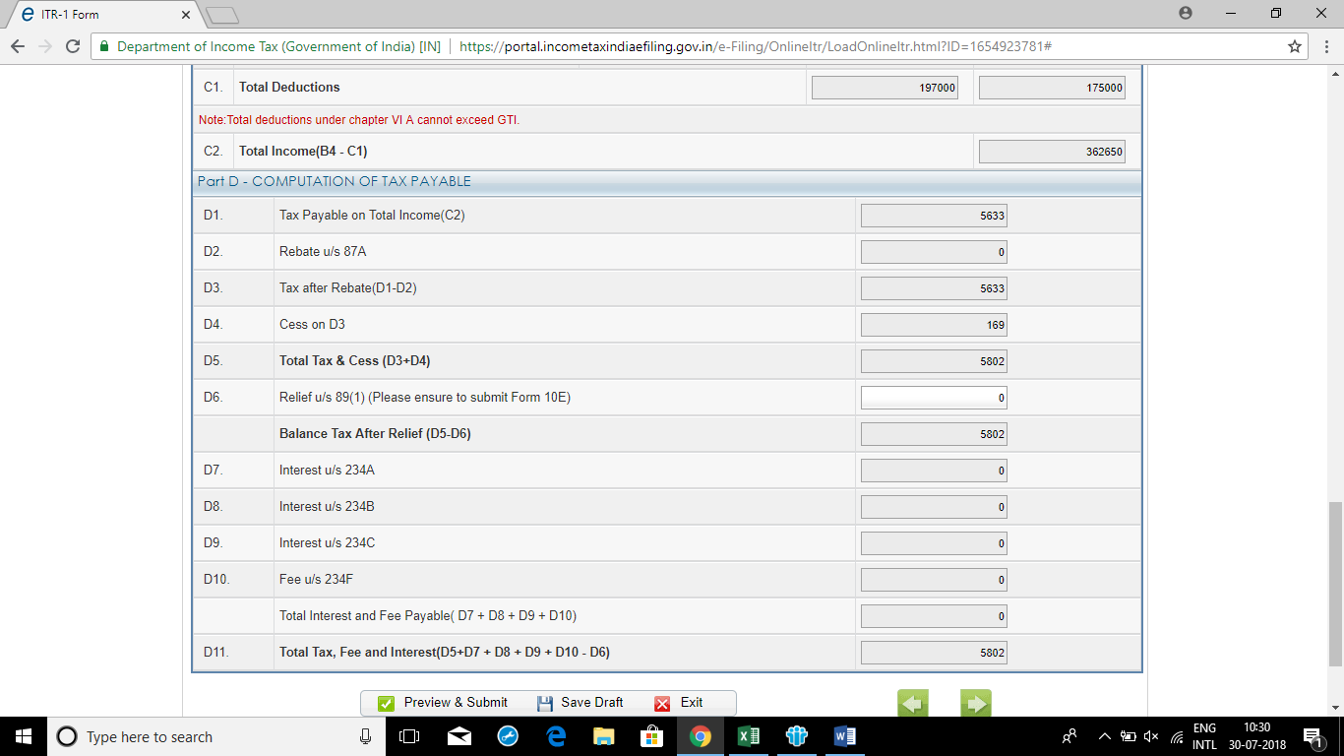
Income Tax E-Filing ( ITR-1)

Slide 87

Income Tax E-Filing ( ITR-1)
Rebate u/s 87A
Limit- Taxable Income-Rs.3,50,000/-

Slide 88
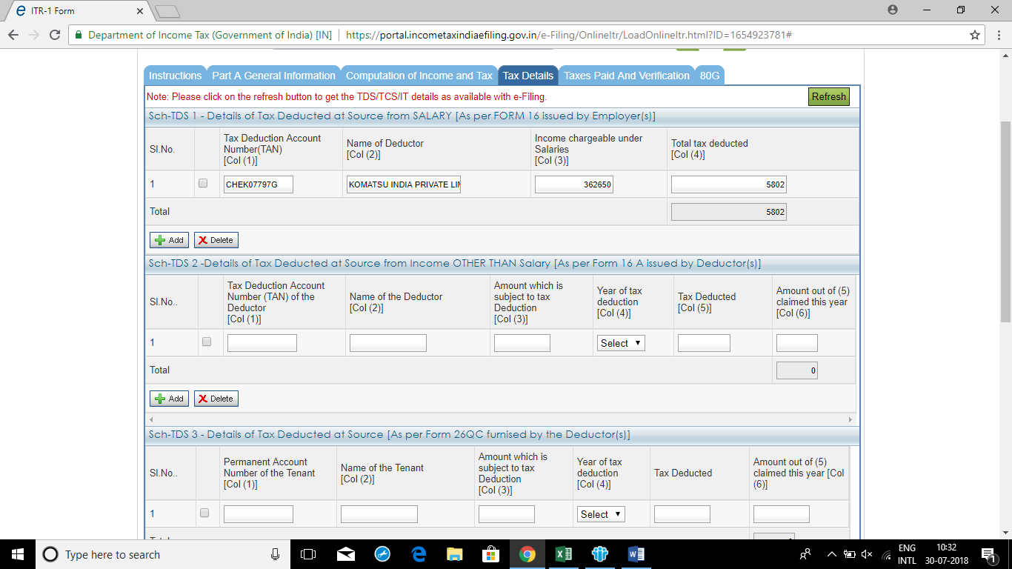
Income Tax E-Filing ( ITR-1)

Slide 89
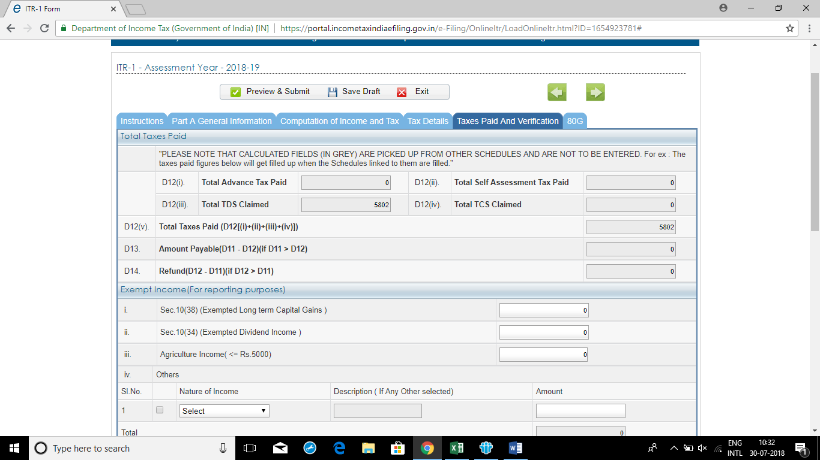
Income Tax E-Filing ( ITR-1)

Slide 90
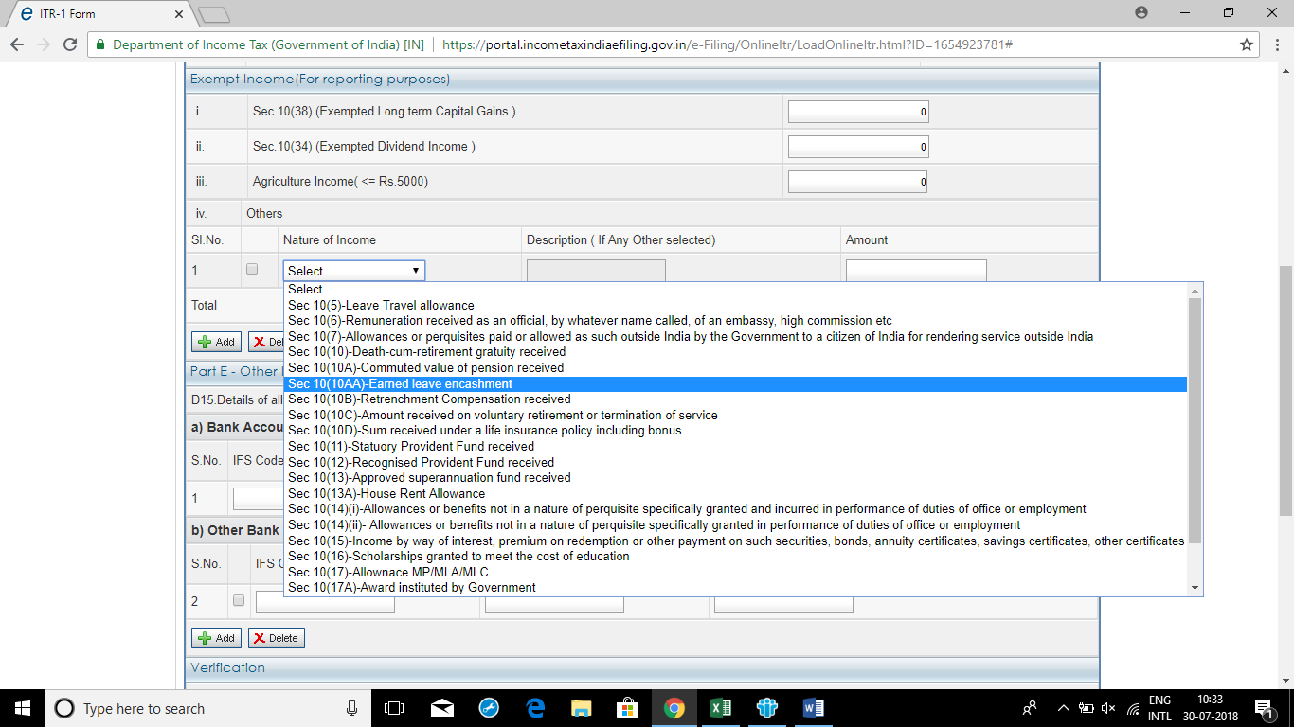
Income Tax E-Filing ( ITR-1)

Slide 91
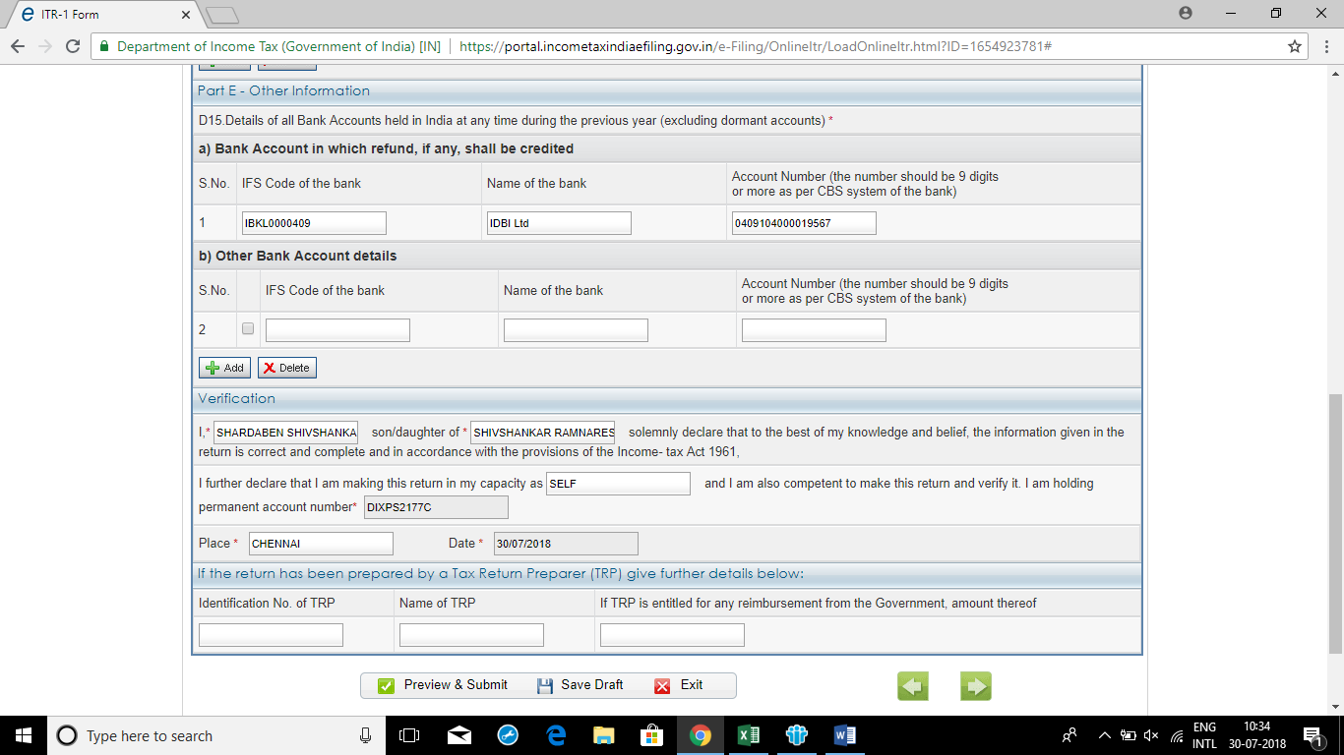
Income Tax E-Filing ( ITR-1)

Slide 92
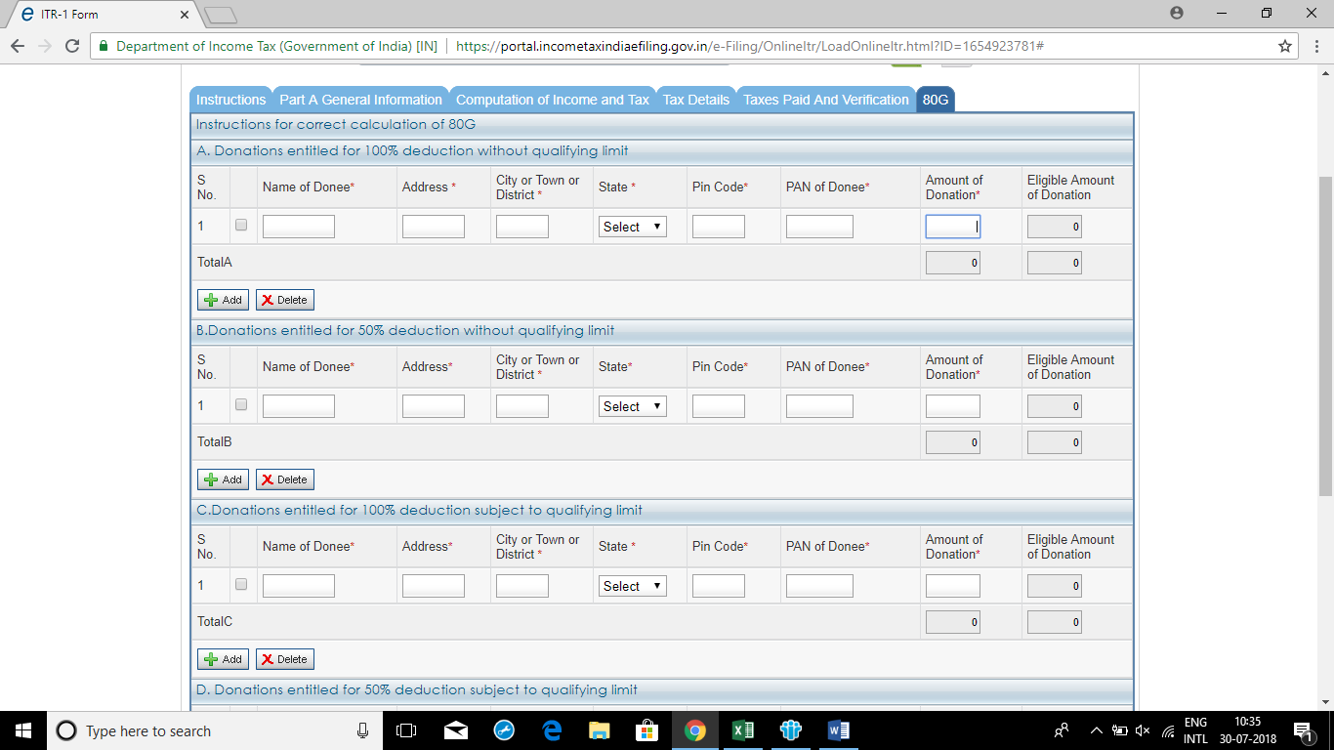
Income Tax E-Filing ( ITR-1)

Slide 93
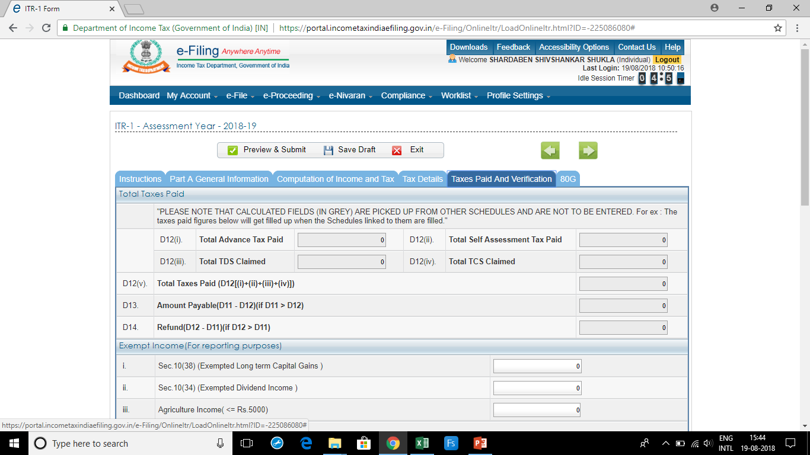
Income Tax E-Filing ( ITR-1)

